Slide 1
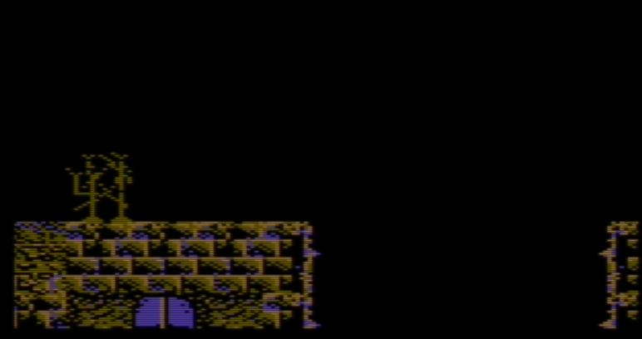
Commodore 64 Game Project Video 1
By C64Brain

Slide 2
Learning to write in assembly language
For the record, the purpose of this video series is not to teach you how to write in assembly language as that would be way more time consuming. Rather, it has been created to give you an inside peek at how your Commodore computer works from a memory perspective, so that you can start creating your own masterpiece projects.
Therefore if you are totally new to learning Assembly Language then I highly suggest finding a good book or website. Spend time learning how to put together small functions, learn how the memory map works, get a grasp on binary bits, and experiment to see what you can come up with. Hopefully following these things will allow you to keep pace with this series as it will start with a small set of files and begin to get larger with each new video release.
Wishing you the best of luck!

Slide 3

Subscribe!
Be sure to subscribe to my YouTube Channel and Facebook page. I look forward to working with you guys and seeing any evolving projects you have as a direct result of the concepts you will learn in this series.
I hope you enjoy this video of the “C64 Brain Your Game Project Video The Facebook page below is available for those who want to learn more or show their current projects and ask questions.
https://www.facebook.com/C64-Brain-102232354880493 (link is also in description below).

Slide 4
Project code downloads
Finally each game project will utilize Github for repository saves so you can download and learn from the code.
Note: It will be necessary to have your own Github account to get access to the files.
C64Brain Github site:
https://github.com/c64brain/commodore64gameproject

Slide 5
WHAT WILL BE LEARNED IN VIDEO 1
The goal of this project is to you tools to create your own games and projects. In this lesson you will gain the following skills:
A knowledge of how the Commodore computer graphics memory work. You will learn how to switch banks to relocate memory where graphics can be stored.
Explore how a character set exists and can be rewritten for your own use (CopyChars). The tool CharPad allows us to create a sample map that can be loaded in memory.
Utilizing 4k of VIC area between ($D000-$DFFF) to access multicolor graphics and foreground/background screen controls.
Loading the CharPad map using the subroutine LoadLevel & DrawMap.

Slide 6
Project 1 FLowchart
Start: Set Bank 1: To place map in graphics memory
CopyChars
Copy character set from ROM to RAM
LoadLevel
Read CharPad data “character set” & “map data”
DrawMap
Creates the game map (10 tiles across, 15 deep) in memory
DrawTile
Creates 4x4 tiles in memory
GetScreenLineAddress
Draws tiles on the screen

Slide 7
Before anything we use the commands IncAsm "VIC_Registers.asm" to connect the VIC registers to our project and the command IncAsm "Game_Macros.asm“ to connect the Macros to our project.
; Commodore 64: "Your Game Project" ; ; File: Project 1 ;==================================================================== ; SCROLLING MAP EXAMPLE 1 - C64 YouTube Game Project ; 2016/17 - Peter 'Sig' Hewett aka RetroRomIcon (contributions) ; 2020 /21- Additional coding by Steve Morrow ;====================================================================Operator Calc ; IMPORTANT - calculations are made BEFORE hi/lo bytes ; in precedence (for expressions and tables) ;==================================================================== IncAsm "VIC_Registers.asm" ; VICII register includes IncAsm "Game_Macros.asm" ; macro includes

Slide 8
Load file
“VIC_Registers.asm”

Slide 9
VIC_Registers.asm
VIC_SPRITE_X_POS = $D000
VIC_SPRITE_Y_POS = $D001
VIC_SPRITE_X_EXTEND = $D010
VIC_SCREEN_CONTROL_Y = $D011
VIC_SCREEN_CONTROL = $D011
VIC_RASTER_LINE = $D012
VIC_SPRITE_ENABLE = $D015
VIC_SCREEN_CONTROL_X = $D016
VIC_CONTROL = $D016
VIC_MEMORY_CONTROL = $D018
VIC_MASK_IRQ = $D019
VIC_INTERRUPT_CONTROL = $D01A
VIC_SPRITE_MULTICOLOR = $D01C
VIC_BORDER_COLOR = $D020
VIC_BACKGROUND_COLOR = $D021
VIC_CHARSET_MULTICOLOR_1 = $D022
VIC_CHARSET_MULTICOLOR_2 = $D023
VIC_CHARSET_MULTICOLOR_3 = $D024
VIC_SPRITE_MULITCOLOR_1 = $D025
VIC_SPRITE_MULTICOLOR_2 = $D026
VIC_SPRITE_COLOR = $D027
PORT A = $DC00
JOY_2 = $DC00
INT_CONTROL = $DC0D
VIC_BANK = $DD00
CIA_PRA = $DD00
PROC_PORT = $0001
COLOR_BLACK = 0
COLOR_WHITE = 1
COLOR_RED = 2
COLOR_CYAN = 3
COLOR_VIOLET = 4
COLOR_GREEN = 5
COLOR_BLUE = 6
COLOR_YELLOW = 7
COLOR_ORANGE = 8
COLOR_BROWN = 9
COLOR_LTRED = 10
COLOR_GREY1 = 11
COLOR_GREY2 = 12
COLOR_LTGREEN = 13
COLOR_LTBLUE = 14
COLOR_GREY3 = 15

Slide 10
Load file
“Game_Macros.asm”

Slide 11
; loadpointer <zeropage_pointer>, <label> ; ; loads the address of <label> into <zeropage_pointer> ; NOTE : the lable MUST be an absolute address ;------------------------------------------------------------------------------- defm loadPointer lda #</2 sta /1 lda #>/2 sta /1 + 1 endm

Slide 12
; copyPointer <source pointer>, <dest pointer> ; ; Copies the contents of one pointer to another ;-------------------------------------------------------------------------------- defm copyPointer lda /1 sta /2 lda /1 + 1 sta /2 + 1 endm

Slide 13
; addPointer <pointer address>, <amount - 00 - ff> ; ; Adds an immediate 1 byte amount to a pointer ;-------------------------------------------------------------------------------- defm addPointer lda /1 clc adc #/2 sta /1 lda /1 + 1 adc #0 sta /1 + 1 endm

Slide 14
; saveRegs ; ; Saves the contents of A, X and Y onto the stack ;---------------------------------------------------------------------------------- defm saveRegs pha ; save A txa pha ; save X tya pha ; save Y endm

Slide 15
; restoreRegs ; ; Pulls saved values off the stack and returns them to A, X and Y ;---------------------------------------------------------------------------------- defm restoreRegs pla tay ; restore Y pla tax ; restore X pla ; restore A endm

Slide 16
Load file
“Main.asm”

Slide 17
Project variables
SCREEN_MEM = $4000 ; Pointer for SCREEN1 memory COLOR_MEM = $D800 ; Color memory never changes CHAR_MEM = $4800 ; Location of CharPad map memory LEVEL_1_MAP = $E000 ; Address for ROM character map memory LEVEL_1_CHARS = $E800 ; Address for ROM character set ;========================================================== ; ZERO PAGE LABELS ;========================================================== PARAM1 = $03 ; Contains CharPad Map binary file data PARAM2 = $04 ; Contains counter character set copying and Map X position data PARAM3 = $05 ; Contains CharPad Y tile data PARAM4 = $06 ; unused in Project #1 PARAM5 = $07 ; Level data counter,

Slide 18
ZEROPAGE_POINTER_1 = $17 ZEROPAGE_POINTER_2 = $19 ZEROPAGE_POINTER_3 = $21 ZEROPAGE_POINTER_4 = $23 MAP_X_POS = $30 ; Current map x position (in tiles) MAP_Y_POS = $31 ; Current map y position (in tiles)

Slide 19
Basic kickstart loader
The following code below recreates the text SYS 2064 and a carriage return is embedded within the bytes to auto start the assembly language program. This saves the time of having to type it in each time the project is compiled and run. Program counter is set to $0801 (2049)
For time preservation of this video, I would go into complete detail, but if you convert the hexadecimal values to decimal and utilize a BASIC command such as PRINT CHR$(byte value) then you can see the text and data for yourself.
KICKSTART
*=$0801
BYTE $0E,$08,$0A,$00,$9E,$20,$28,$32,$30,$36,$34,$29,$00,$00,$00

Slide 20
Relocating video memory
When the computer is first turned on, the memory defaults are setup specifically for BASIC allocation. However, this leaves little room to add more sprites and graphics data. Therefore since the VIC II chip can only see 16k of video memory at a time, it is necessary to create more space when designing a large map and needing a lot of sprites, character set data, etc. Below is some sample code that I will take time to explain. This is called “banking” video memory and is the best method when you want to build a much larger project.
In this video, I will also be switching back in forth between code examples, and providing more in depth explanations.

Slide 21
SET VIC 16K memory to Bank 1
The example seen below is using Bank 1 ($DD00 = 56576) and is perfect for us since there is an extra 8k (kilobytes) that can be reserved for sprites and character data (2k). AND = removes bits. ORA = restores bits.
*=$0810 (2064 – decimal)
lda VIC_BANK ; Fetch the status of CIA 2 ($DD00)
and #%11111100 ; mask for bits 2-8, retain bits 0-1
ora #%00000010 ; first 2 bits are VIC bank value (2)
sta VIC_BANK ; turns on bits 0-1, set to Bank 1

Slide 22
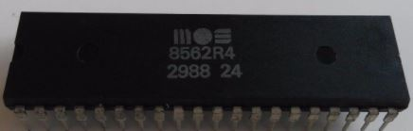
An inside look at vic ii’s memory
Highlighted is the one in use for our project
Bank 0 BASIC default. Sprite memory limits. Character ROM must be copied to RAM | Bank 1 Large area Available for sprites and character data. Character ROM must be copied to RAM | Bank 2 Large area available for sprites and character data. Limits on bitmap memory. | Bank 3 4k of I/O registers. 8k operating system Kernal ROM. Character ROM is not available.

Slide 23
For those who may need a clearer picture of what is going on, I have extracted a diagram I found in the book “Compute!’s reference guide to Commodore 64 Graphics”. By looking at each image you can hopefully understand how the VIC II can set memory as follows. Highlighted below is the one in use.
Bank 3 = Memory registers 49152-65535 ($C000-$FFFF)
Bank 2 = Memory registers 32768-49151 ($8000-$BFFF)
Bank 1 = Memory registers 16384-32767 ($4000-$7FFF)
Bank 0 = Memory registers 0000-16383 ($0000-$3FFF)

Slide 24
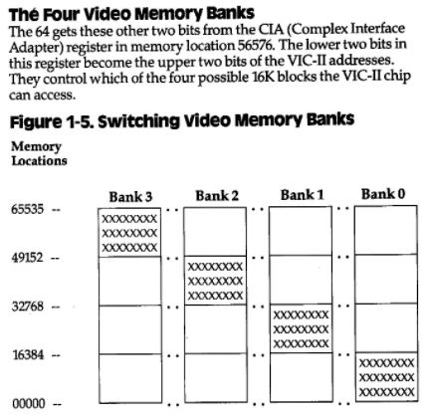
Visual of the VIC II CIA memory
Each slot is limited to 16k of memory, starting at the lowest bits to the highest. For Bank 1 that we will be using, the Character generator ROM must be moved so we can alter it.
2k of this memory can be used for character graphics (if allowed). Sprite data can be placed in any of 256 groups of 64 bytes each. Finally text screen memory can occupy any of the 16k areas.

Slide 25
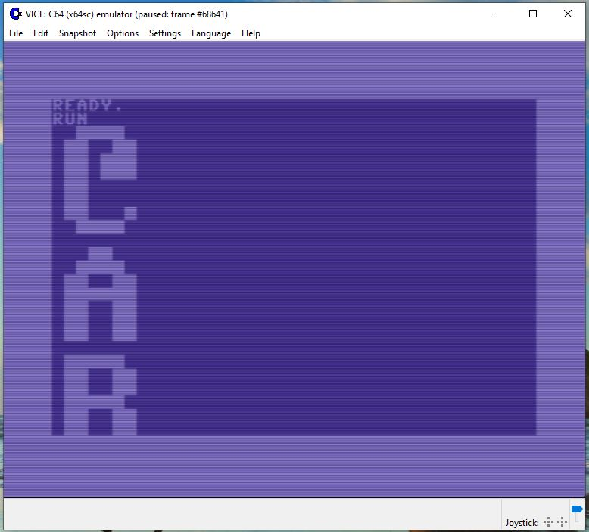
A basic example of bank switching
Below is a program found in the book Compute!’s reference guide to Commodore 64 Graphics” that demonstrates how to view a character set stored in ROM memory without copying it to RAM. Hopefully this will help you understand where the character set (that makes up the letters, numbers, and symbols that can be entered from the keyboard) exists at in memory.
10 FOR R=53248 TO 57343 20 POKE 56334,0: POKE 1,51 30 A=PEEK(R) 40 POKE1,51: POKE 56334,1 50 G$=“” 60 FOR F=0 TO 7 70 IF A/2=INT(A/2) THEN G$=“”+G$:GOTO 90 80 G$=CHR$(18)+CHR$(32)+CHR$(146)+G$ 90 A=INT(A/2): NEXT 100 PRINT G$ 110 NEXT

Slide 26
Example of bit masking
When the VICE C64 emulator first loads, registers are set by default to Bank 0. To learn about how banking works. I am providing a simple example so you can see the “bits” as they are translated. The example below takes the number 151, reserves bits 0-1 and masks out “removes” bits 2-7 (in total). This is known as a “Bitwise AND/ORA”. Bit masking is necessary to keep specific bits, while discarding the others. A common example seen in games is turning off certain sprites after the player kills them, while keeping the other sprites enabled on the screen. The example below is used to switch from Bank 0 to Bank 1 via register CIA #2. There wasn’t enough room to also demonstrate ORA here, so it’s divided in 2 parts.
In memory (accumulator): Register $DD00 = $97 (151)
Bits
7 | 6 | 5 | 4 | 3 | 2 | 1 | 0
Value = $97 (151)
1 | 0 | 0 | 1 | 0 | 1 | 1 | 1
AND #$FC
1 | 1 | 1 | 1 | 1 | 1 | 0 | 0
1 | 0 | 0 | 1 | 0 | 1 | 0 | 0

Slide 27
Bitwise ORA
As long as a “1” exists, with ORA that bit will be a “1, otherwise it will have a “0” result.
Bits
7 | 6 | 5 | 4 | 3 | 2 | 1 | 0
Result left after first AND #2
1 | 0 | 0 | 1 | 0 | 1 | 0 | 0
ORA #2
0 | 0 | 0 | 0 | 0 | 0 | 1 | 0
Final results after clearing & setting of bits
1 | 0 | 0 | 1 | 0 | 1 | 1 | 0

Slide 28
Copy map to memory (for later)
In this next example we read the value from PROC_PORT (register $0000) and save it. Then we switch out BASIC, KERNAL, CHAREN, IO and save the result in PROC_PORT. This was originally written this way to save the map tiles so they can be restored later when the game resets, although we may not see this happen in this project series unless we decide to create a new level.
System_Setup
Write CharPad map data to RAM under the KERNAL at $E000. Normally it just reads from the ROM here.
sei
; Here you load and store the Processor Port ($0001), then use it to turn off LORAM (BASIC), HIRAM (KERNAL), CHAREN (CHARACTER ROM) ; then use a routine to copy your sprite and character memory under there ; before restoring the original value of $0001 and turning interrupts ; back on.
lda PROC_PORT ; store ram setup
sta PARAM1
lda #%00110000 ; Switch out BASIC, KERNAL, CHAREN, IO
sta PROC_PORT

Slide 29
Next we use some Macros to reduce repetitive code. The Macro loadPointer below utilizes the load/save techniques common with LDA and STA. Macros are found in file Game_Macros.asm (that we reviewed earlier briefly).
When the game starts, Level 1 tiles and characters are stored in place to run. However, when the game resets we will need to restore these levels intact. So we're saving them away to load later under the KERNAL at $E000-$EFFF (4k). To do this we need to do some bank switching, copy data, then restore as is.
loadPointer ZEROPAGE_POINTER_1, MAP_MEM ; source
loadPointer ZEROPAGE_POINTER_2, LEVEL_1_MAP ; destination

Slide 30
Copy character generator rom to memory
MAP_MEM reads from incbin"Parkour_Maps/Parkour Redo Map6.bin“ then copies the tile data to the variable ZEROPAGE_POINTER_1
LEVEL_1_MAP reads from $E000 (ROM memory) and copies the character set data to ZEROPAGE_POINTER_2
jsr CopyChars ; copies 2048 (2k) of character data

Slide 31
Now that we have the character set copied (from $4800) – using the command incbin"Parkour_Maps/Parkour Redo Chset6.bin“ (which contains our CharPad binary file), we can then setup the tiles to be copied over next. You will learn more about these later when we explore the map design using the CharPad tool.
; ZEROPAGE_POINTER_1 = CHAR_MEM ; Points to our CharPad tile data ; ZEROPAGE_POINTER_2 = LEVEL_1_CHARS
loadPointer ZEROPAGE_POINTER_1, CHAR_MEM ; CHAR_MEM = $E000 loadPointer ZEROPAGE_POINTER_2, LEVEL_1_CHARS ; LEVEL_1_CHARS = $E800

Slide 32
Finally call the subroutine “CopyChars” again to copy the character set to memory this time and restore the level data. Then we re-enable interrupts with “cli”.
; CHAR_MEM = $E000
Character memory reads from $E000 (LEVEL_1_CHARS) and saves 2k (2048 bytes) to the variable ZEROPAGE_POINTER_2 to reserve for future map levels.
jsr CopyChars lda PARAM1 ; restore ram setup sta PROC_PORT cli

Slide 33
Set up multicolor screen
Screen_Setup lda #COLOR_BLACK sta VIC_BACKGROUND_COLOR lda #COLOR_ORANGE sta VIC_CHARSET_MULTICOLOR_1 lda #COLOR_BROWN sta VIC_CHARSET_MULTICOLOR_2

Slide 34
Next get X and Y tile coordinates to be positioned on the screen using the subroutines “LoadLevel” and “DrawMap”. ;========================================================== ; MAP POSITION ;==========================================================; ---------------------------CHARPAD LEVEL SETUP ------------------------------------ lda #1 ; Start Level = 1 sta CURRENT_LEVEL jsr LoadLevel ; load level 1 data ldx #27 ; Y start position (in tile coordinates) (100, 49=default map size) ldy #0 ; X start position (in tile coordinates) jsr DrawMap ; Draw the level map (Screen1) and initialize it

Slide 35
Now we focus on fixing a bad line that appears at the bottom of the screen using VIC_SCREEN_CONTROL, set the border color, and enable multicolors for our map display. lda #%00011000 ; Turn on active screen (bit 4), fix bad line sta VIC_SCREEN_CONTROL lda #COLOR_BLACK sta VIC_BORDER_COLOR lda #% 00010000 sta VIC_SCREEN_CONTROL_X ; $D016 - (53270) - multicolor control

Slide 36
Set VIC II Character memory
By default when VICE (Commodore computer) is first turned on, the Character Generator ROM is contained in 2k of memory between ($D000-$D800 – 53248 – 55296), which contains the upper/lowercase set. Since we are using Bank 1, VIC II does not have access to the Character Generator ROM (Read Only Memory) so it must be copied into RAM (Random Access Memory) where we can change the data to create our own map. The code below shows how to switch to the character set in memory and later we will copy it. We use bits 0-1, which point to the location of the Character Dot-Data area. By default the characters you see on the screen are safely tucked away in ROM even when you turn off your computer.
There are only 8 possible location instructions for character memory. In the VIC BANK we can set our screen and character memory areas. Here we have relocated this using register $D018 (VIC_MEMORY_CONTROL).
lda #%00000010 ; bits 1-3 (001) = pointer to character memory 2: $0800
sta VIC_MEMORY_CONTROL

Slide 37
The Mainloop subroutine is needed to keep the project active and not exiting to Basic in the VICE C64 emulator. In later projects, subroutines will be looped consistently when the joystick is in use, sprites are moving on the screen, etc.
;==================================================================== ; MAIN LOOP ;==================================================================== MainLoop jmp MainLoop ;==================================================================== ; FILES IN GAME PROJECT ;==================================================================== incAsm "Game_Routines.asm" ; core framework routines incAsm "Screen_Memory.asm" ; screen drawing and handling incAsm "Start_Level.asm"

Slide 38
Load the character set data from CharPad and store it in address $4800. This is used in “Screen_Memory.asm” later to display tiles on the screen. *=$4800 MAP_CHAR_MEM ; CharPad Character set for map screen incbin"Parkour_Maps/Parkour Redo Chset6.bin"

Slide 39
*=$5C00 ; Reserve later for sprites ;==================================================================== ; LEVEL DATA ;==================================================================== ; Each Level has a character set (2k) an attribute/color list (256 bytes), 4x4 tiles (1k) ; and a 100 x 49 map range. ; The current level map will be put at $8000 with Attribute lists (256 bytes) and Tiles (1k) ; Starting after it at $8800. *=$8000 MAP_MEM ; CharPad’s binary “map” data incbin "Parkour_Maps/Parkour Redo Map6.bin" ATTRIBUTE_MEM ; CharPad’s binary “attribute” data incbin "Parkour_Maps/Parkour Redo ChsetAttrib6.bin" TILE_MEM ; CharPad’s binary “tileset” data incbin "Parkour_Maps/Parkour Redo Tileset6.bin"

Slide 40
Load file
“Game_Routines.asm”

Slide 41
Load File: Game_routines.asm
Now we load our first file. In CBM Prg Studio this is done using incAsm "Game_Routines.asm“. This is obtained after we used the jsr CopyChars subroutine. The code below is simply copying the Character Generator ROM ($E000) to RAM memory so we can change to our new character set. This will then contain our map area that was created in CharPad. NOTE: Code extends to several slides.
;==================================================================== ; COPY CHARACTER SET TO MEMORY ;====================================================================CopyChars
saveRegs
ldx #$00 ; clear X, Y, A and PARAM2 ldy #$00 lda #$00 sta PARAM2

Slide 42
CopyChars: cont
; MAP_MEM = ZEROPAGE_POINTER_1 ; LEVEL_1_MAP = ZEROPAGE_POINTER_2
; CHAR_MEM = ZEROPAGE_POINTER_1 ; LEVEL_1_CHARS = ZEROPAGE_POINTER_2 @NextLine lda (ZEROPAGE_POINTER_1), y ; MAP_MEM / CHAR_MEM – map data sta (ZEROPAGE_POINTER_2), y ; LEVEL_1_MAP / LEVEL_1_CHARS inx ; increment x iny ; increment y cpx #$08 ; test for next character block (8 bytes) bne @NextLine ; copy next line cpy #$00 ; test for edge of page (256 wraps back to 0) bne @PageBoundryNotReached inc ZEROPAGE_POINTER_1 + 1 ; if reached 256 bytes, increment high byte inc ZEROPAGE_POINTER_2 + 1 ; of source and target

Slide 43
Copychars: cont
@PageBoundryNotReached inc PARAM2 ; Only copy 254 characters (to keep irq vectors intact) lda PARAM2 ; If copying to F000-FFFF block cmp #255 beq @CopyCharactersDone ldx #$00 jmp @NextLine @CopyCharactersDone restoreRegs rts

Slide 44
Load file
“Screen_Memory.asm”

Slide 45
This is used to place CharPad map data in screen memory so it appears on the display.
GetScreenLineAddress lda SCREEN1_LINE_OFFSET_TABLE_LO, y ; Use Y to lookup the address and save it in sta ZEROPAGE_POINTER_1 ; ZEROPAGE_POINTER_1 lda SCREEN1_LINE_OFFSET_TABLE_HI, y sta ZEROPAGE_POINTER_1 + 1 rts

Slide 46
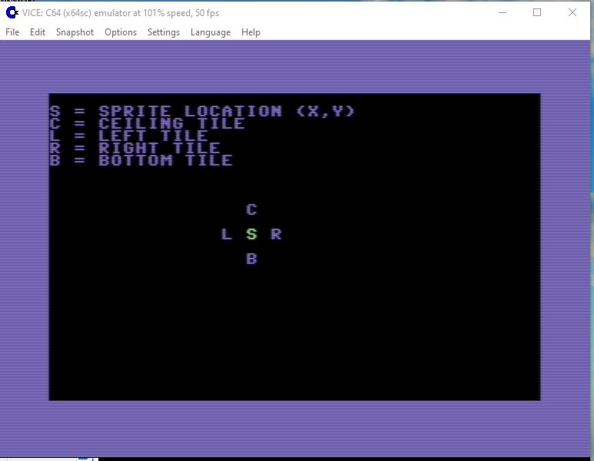
Looking at the map’s screen memory
The following routines check for SCREEN1 or SCREEN2 and read the screen memory address lines from a table. These come in handy later when a sprite needs to check the area around it (top, bottom, left, and right). So for example if our map were a simple 1x1 layout and we were standing at screen memory address “1400”, the tile underneath it would be “1440”. Our map is arranged differently, but I’m hoping that the VICE example makes it easier to understand.
GetScreenLineAddress lda CURRENT_SCREEN + 1 jmp detectScreen FetchBufferLineAddress lda CURRENT_BUFFER + 1 detectScreen cmp #>SCREEN1_MEM beq @screen1 cmp #>SCREEN2_MEM beq @screen2

Slide 47
SCREEN 1 MEMORY TABLES
SCREEN_LINE_OFFSET_TABLE_LO SCREEN1_LINE_OFFSET_TABLE_LO byte <SCREEN_MEM byte <SCREEN_MEM + 40 byte <SCREEN_MEM + 80 byte <SCREEN_MEM + 120 byte <SCREEN_MEM + 160 byte <SCREEN_MEM + 200 byte <SCREEN_MEM + 240 byte <SCREEN_MEM + 280 byte <SCREEN_MEM + 320 byte <SCREEN_MEM + 360 byte <SCREEN_MEM + 400 byte <SCREEN_MEM + 440 byte <SCREEN_MEM + 480 byte <SCREEN_MEM + 520 byte <SCREEN_MEM + 560 byte <SCREEN_MEM + 600 byte <SCREEN_MEM + 640 byte <SCREEN_MEM + 680 byte <SCREEN_MEM + 720 byte <SCREEN_MEM + 760 byte <SCREEN_MEM + 800 byte <SCREEN_MEM + 840 byte <SCREEN_MEM + 880 byte <SCREEN_MEM + 920 byte <SCREEN_MEM + 960

Slide 48
SCREEN_LINE_OFFSET_TABLE_HI SCREEN1_LINE_OFFSET_TABLE_HI byte >SCREEN_MEM byte >SCREEN_MEM + 40 byte >SCREEN_MEM + 80 byte >SCREEN_MEM + 120 byte >SCREEN_MEM + 160 byte >SCREEN_MEM + 200 byte >SCREEN_MEM + 240 byte >SCREEN_MEM + 280 byte >SCREEN_MEM + 320 byte >SCREEN_MEM + 360 byte >SCREEN_MEM + 400 byte >SCREEN_MEM + 440 byte >SCREEN_MEM + 480 byte >SCREEN_MEM + 520 byte >SCREEN_MEM + 560 byte >SCREEN_MEM + 600 byte >SCREEN_MEM + 640 byte >SCREEN_MEM + 680 byte >SCREEN_MEM + 720 byte >SCREEN_MEM + 760 byte >SCREEN_MEM + 800 byte >SCREEN_MEM + 840 byte >SCREEN_MEM + 880 byte >SCREEN_MEM + 920 byte >SCREEN_MEM + 960

Slide 49
COLOR MEMORY TABLES
COLOR_LINE_OFFSET_TABLE_LO byte <COLOR_MEM byte <COLOR_MEM + 40 byte <COLOR_MEM + 80 byte <COLOR_MEM + 120 byte <COLOR_MEM + 160 byte <COLOR_MEM + 200 byte <COLOR_MEM + 240 byte <COLOR_MEM + 280 byte <COLOR_MEM + 320 byte <COLOR_MEM + 360 byte <COLOR_MEM + 400 byte <COLOR_MEM + 440 byte <COLOR_MEM + 480 byte <COLOR_MEM + 520 byte <COLOR_MEM + 560 byte <COLOR_MEM + 600 byte <COLOR_MEM + 640 byte <COLOR_MEM + 680 byte <COLOR_MEM + 720 byte <COLOR_MEM + 760 byte <COLOR_MEM + 800 byte <COLOR_MEM + 840 byte <COLOR_MEM + 880 byte <COLOR_MEM + 920 byte <COLOR_MEM + 960

Slide 50
COLOR_LINE_OFFSET_TABLE_HI byte >COLOR_MEM byte >COLOR_MEM + 40 byte >COLOR_MEM + 80 byte >COLOR_MEM + 120 byte >COLOR_MEM + 160 byte >COLOR_MEM + 200 byte >COLOR_MEM + 240 byte >COLOR_MEM + 280 byte >COLOR_MEM + 320 byte >COLOR_MEM + 360 byte >COLOR_MEM + 400 byte >COLOR_MEM + 440 byte >COLOR_MEM + 480 byte >COLOR_MEM + 520 byte >COLOR_MEM + 560 byte >COLOR_MEM + 600 byte >COLOR_MEM + 640 byte >COLOR_MEM + 680 byte >COLOR_MEM + 720 byte >COLOR_MEM + 760 byte >COLOR_MEM + 800 byte >COLOR_MEM + 840 byte >COLOR_MEM + 880 byte >COLOR_MEM + 920 byte >COLOR_MEM + 960

Slide 51
Load file
“Start_Level.asm”

Slide 52
“start_level.asm”
The code below prepares the screen for the placement of our map from CharPad. It does this by saving screen memory variables that place addresses in them. ;==================================================================== ; SETUP GAME LEVEL ;==================================================================== ; Loading a level and getting it ready for play ;------------------------------------------------------------------------------------------------------------------ LoadLevel ldx CURRENT_LEVEL ; Load current level number dex ; subtract 1 (levels start at 1 not 0) txa lsr ; multiply by 2 to get a word offset tax ; put it in x to lookup our table sta PARAM5 ; save in scratch parameter (5)

Slide 53
Get rom character set in memory
Begin loading the character set data from ROM based on level of game @loadBanked sei lda PROC_PORT sta PARAM1 lda #$35 ; Switch out BASIC, KERNAL, CHAREN, IO sta PROC_PORT ; CPU sees RAM everywhere except at $D000-$E000 ldx PARAM5 ; As level increases, could point to different character sets lda CHAR_ADDRESS, x ; LEVEL_1_CHARS = $E800 (read character set data from ROM) sta ZEROPAGE_POINTER_1 lda CHAR_ADDRESS + 1, x ; LEVEL_1_CHARS = $E800 (read character set data from ROM) sta ZEROPAGE_POINTER_1 + 1 loadPointer ZEROPAGE_POINTER_2, CHAR_MEM jsr CopyChars

Slide 54
Copy charpad map to memory
Copy the CharPad chset binary file data and get ROM character set copied to memory. The x register here manages which level of table data we are pointing to for the map. Copies CharPad chset binary file tileset data from address $4800 (CHAR_MEM) loadPointer ZEROPAGE_POINTER_2, CHAR_MEM ; CHAR_MEM = where tiles are at jsr CopyChars ; Copy ROM character set to RAM memory
ldx PARAM5 ; manages which level of data we are pointing to for the map
; MAP_ADRESS - gets character set from ROM (points to LEVEL_1_MAP = $E000)
lda MAP_ADDRESS, x sta ZEROPAGE_POINTER_1 lda MAP_ADDRESS + 1, x sta ZEROPAGE_POINTER_1 + 1 loadPointer ZEROPAGE_POINTER_2, MAP_MEM jsr CopyChars ; Copy CharPad map binary file data to memory lda PARAM1 sta PROC_PORT cli rts

Slide 55
Plot out map coordinates (x, y)
;========================================================== ; DRAW MAP ON THE SCREEN ;========================================================== ; Draw the entire map on the screen. Setup X and Y map positions. X = Start map X coordinates (top left corner) Y = Start map Y coordinates (top left corner) DrawMap lda #0 stx MAP_X_POS ; CharPad map binary file X position sty MAP_Y_POS ; CharPad map binary file Y position

Slide 56
Copy charpad data down the screen
; First find the address for the starting map position and begin reading the CharPad map data to the screen from top to bottom. ldx MAP_Y_POS ; Count over to where first CharPad map area is seen (X direction) lda MAP_LINE_LOOKUP_LO, x ; fetch the address for the line (Y position) sta ZEROPAGE_POINTER_4 lda MAP_LINE_LOOKUP_HI, x sta ZEROPAGE_POINTER_4 + 1 clc lda ZEROPAGE_POINTER_4 ; add the x position adc MAP_X_POS sta ZEROPAGE_POINTER_4 lda ZEROPAGE_POINTER_4 + 1 adc #0 sta ZEROPAGE_POINTER_4 + 1 ; ZEROPAGE_POINTER_1 now holds the map start address

Slide 57
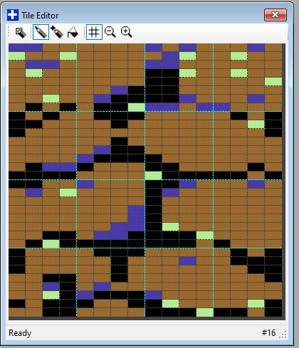

This section begins the laying of the 4 x 4 tiles that are used for our game map. If you look at the CharPad example you will see that they are stacked on top of each other. See the example here. There are 4 tiles going left to right and 4 tiles going top to bottom. Beside it is an example of a tile as seen in the game. ldy #0 ; holds X screen position (MAP_X_POS) ldx #0 ; holds Y screen position (MAP_Y_POS)
; ZEROPAGE_POINTER_4 = MAP_MEM @loop lda (ZEROPAGE_POINTER_4), y ; fetch map data jsr DrawTile ; draw the tile

Slide 58
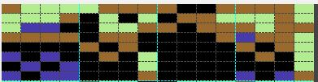
Read the first tile line
The “addPointer” macro is used to read 100 tiles from the CharPad map (total length). This line can be changed to fit your exact map. So if you only have a map that is 50 tiles it can be changed here.
Draw 10 tiles side by side across the screen and 5 character data tiles side by side. These manage what can be currently seen as the map is displayed and scrolled (in Video 2). Note: the subroutine “DrawTile” is what places them on the screen. The example below contains 4 tiles. So when we reach number 5 we are done (it never gets drawn).
iny ; inc X and check for end of screen cpy #10 ; from left to right bne @loop ; go down one line on the map addPointer ZEROPAGE_POINTER_4, 100 ldy #0 inx cpx #5 (1-4 in a row) bne @loop rts
1 2 3 4

Slide 59
prepare tiles for the main screen
;==================================================================== ; PLACE 4X4 TILES ON THE SCREEN ;==================================================================== ; This sections draws 4x4 tiles using PARAM2, which goes to the right ; and PARAM3 which draws the tile going down. ;--------------------------------------------------------------------------------- ;
; PARAM1 = CharPad Map Binary file data (MAP_MEM) ; PARAM2 = CharPad Map tile X position ; PARAM3 = CharPad Map file Y position DrawTile sta PARAM1 ; save tile number sty PARAM2 ; save X pos (PARAM2 = PARAM2 + 1). Counts 10 across the screen stx PARAM3 ; save Y pos (PARAM3 = PARAM3 + 1). Counts 4 tiles side by side saveRegs ; put registers on the stack to ; exit cleaner - this routine will ; likely be nested

Slide 60
Copy color ram to memory
; First get the destination for the tile lda PARAM3 ; fetch the Y position (in tile coordinates) asl asl ; draw 4 tiles side by side going down (Y position) jsr GetScreenLineAddress ; fetch current line address. Used for collision detection later to read tile data under the sprite lda COLOR_LINE_OFFSET_TABLE_LO, x ; fetch color ram line address too sta ZEROPAGE_POINTER_3 lda COLOR_LINE_OFFSET_TABLE_HI, x sta ZEROPAGE_POINTER_3 + 1

Slide 61
Place tiles on the screen
lda PARAM2 ; get CharPad map X position asl asl tax ; draw 4 tiles going to the left (X position) clc ; add to Y line address adc ZEROPAGE_POINTER_1 ; points to screen memory table sta ZEROPAGE_POINTER_1 lda ZEROPAGE_POINTER_1 + 1 adc #0 sta ZEROPAGE_POINTER_1 + 1 txa clc adc ZEROPAGE_POINTER_3 ; points to color ram memory sta ZEROPAGE_POINTER_3 lda ZEROPAGE_POINTER_3 + 1 adc #0 sta ZEROPAGE_POINTER_3 + 1

Slide 62
Read in charpad tile data
; Fetch the source tile address and copy them to zero page pointers.
MAP_MEM = ZEROPAGE_POINTER_2 (CharPad map binary file data) ldx PARAM1 ; Contains the CharPad Map binary tile data lda TILE_NUMBER_LOOKUP_LO, x ; CharPad tileset data sta ZEROPAGE_POINTER_2 lda TILE_NUMBER_LOOKUP_HI, x ; CharPad tileset data sta ZEROPAGE_POINTER_2 + 1

Slide 63
Get color “attribute” data
; Loop through and draw the tile. The “attribute” data from CharPad is also stored here so we can detect other things on the screen (like water, etc.) ldy #0 @drawloop lda (ZEROPAGE_POINTER_2), y ; Get the character code sta (ZEROPAGE_POINTER_1), y ; store it on the screen tax ; pass to X as an offset lda ATTRIBUTE_MEM, x ; fetch the CharPad color attribute binary data sta (ZEROPAGE_POINTER_3), y ; write it to color ram cpy #15 ; drawn the 15th character going down? We're finished beq @done

Slide 64
Place 4 tiles side by side
By masking out the first 2 bits in the accumulator (“00000011”), we get a number that counts 0-3 over and over without stopping the data fetch count 0-15.
tya ; save Y before the increment for our test iny ; (saves having to inc it in 2 diff places). Count 0-3 to draw a row of tiles and #%00000011 ; count from 0-15 (attributes) to fetch the tile data cmp #3 ; both need to use indirect Y addressing, and saving bne @drawloop ; fetching Y rapidly becomes a tangled nightmare.

Slide 65
Continue to place “tiles” on the screen. When advancing to a new line down in screen memory we add “40” since the screen goes across 40 characters.
clc ; add new line lda ZEROPAGE_POINTER_1 ; increment destination and color ram by 1 line - 4 chars adc #40 - 4 sta ZEROPAGE_POINTER_1 ; by 'backsetting' our pointers, we don't need to change Y lda ZEROPAGE_POINTER_1 + 1 ; when drawing 0-3 characters, and can leave the 0-15 adc #0 ; count intact. sta ZEROPAGE_POINTER_1 + 1 ; We have to increase them to the next line anyways, so this ; only saves time.

Slide 66
Loop until all tiles are drawn
Get the “hi bytes” of our screen memory tiles while drawing down the screen.
clc lda ZEROPAGE_POINTER_3 adc #40 - 4 sta ZEROPAGE_POINTER_3 lda ZEROPAGE_POINTER_3 + 1 adc #0 sta ZEROPAGE_POINTER_3 + 1 jmp @drawloop @done restoreRegs ; pull registers back off the stack rts

Slide 67
;========================================================== ; LEVEL DATA AND TABLES ;========================================================== ; CHAR_ADDRESS = CharPad character set data ; ATTRIB_ADDRESS = CharPad attribute color data ; TILE_ADDRESS = CharPad tileset data ; MAP_ADDRESS = CharPad map data
CURRENT_LEVEL byte 0 CHAR_ADDRESS word LEVEL_1_CHARS ATTRIB_ADDRESS word ATTRIBUTE_MEM TILE_ADDRESS word TILE_MEM MAP_ADDRESS word LEVEL_1_MAP

Slide 68
Map data lookup tables
The following table looks up map data (low bytes) loaded from CharPad, used for tile screen drawing. Can be expanded or altered to fit your exact map screen size. ; MAP_LINE_LOOKUP_LO byte <MAP_MEM byte <MAP_MEM + 100 byte <MAP_MEM + 200 byte <MAP_MEM + 300 byte <MAP_MEM + 400 byte <MAP_MEM + 500 byte <MAP_MEM + 600 byte <MAP_MEM + 700 byte <MAP_MEM + 800 byte <MAP_MEM + 900 byte <MAP_MEM + 1000 ; 10 byte <MAP_MEM + 1100 byte <MAP_MEM + 1200 byte <MAP_MEM + 1300 byte <MAP_MEM + 1400 byte <MAP_MEM + 1500 byte <MAP_MEM + 1600 byte <MAP_MEM + 1700 byte <MAP_MEM + 1800 byte <MAP_MEM + 1900

Slide 69
byte <MAP_MEM + 2000 ;20 byte <MAP_MEM + 2100 byte <MAP_MEM + 2200 byte <MAP_MEM + 2300 byte <MAP_MEM + 2400 byte <MAP_MEM + 2500 byte <MAP_MEM + 2600 byte <MAP_MEM + 2700 byte <MAP_MEM + 2800 byte <MAP_MEM + 2900 byte <MAP_MEM + 3000 ;30 byte <MAP_MEM + 3100 byte <MAP_MEM + 3200 ;32

Slide 70
byte <MAP_MEM + 3300 byte <MAP_MEM + 3400 byte <MAP_MEM + 3500 byte <MAP_MEM + 3600 byte <MAP_MEM + 3700 byte <MAP_MEM + 3800 byte <MAP_MEM + 3900 byte <MAP_MEM + 4000 byte <MAP_MEM + 4100 byte <MAP_MEM + 4200 byte <MAP_MEM + 4300 byte <MAP_MEM + 4400 byte <MAP_MEM + 4500

Slide 71
byte <MAP_MEM + 4600 byte <MAP_MEM + 4700 byte <MAP_MEM + 4800 byte <MAP_MEM + 4900 byte <MAP_MEM + 5000 byte <MAP_MEM + 5010 byte <MAP_MEM + 5020 byte <MAP_MEM + 5030 byte <MAP_MEM + 5040 byte <MAP_MEM + 5050

Slide 72
MAP_LINE_LOOKUP_HI byte >MAP_MEM byte >MAP_MEM + 100 byte >MAP_MEM + 200 byte >MAP_MEM + 300 byte >MAP_MEM + 400 byte >MAP_MEM + 500 byte >MAP_MEM + 600 byte >MAP_MEM + 700 byte >MAP_MEM + 800 byte >MAP_MEM + 900 byte >MAP_MEM + 1000 ; 10 byte >MAP_MEM + 1100 byte >MAP_MEM + 1200 byte >MAP_MEM + 1300 byte >MAP_MEM + 1400 byte >MAP_MEM + 1500 byte >MAP_MEM + 1600 byte >MAP_MEM + 1700 byte >MAP_MEM + 1800 byte >MAP_MEM + 1900

Slide 73
byte >MAP_MEM + 2000 ;20 byte >MAP_MEM + 2100 byte >MAP_MEM + 2200 byte >MAP_MEM + 2300 ; byte >MAP_MEM + 4700 byte >MAP_MEM + 2400 byte >MAP_MEM + 2500 byte >MAP_MEM + 2600 byte >MAP_MEM + 2700 byte >MAP_MEM + 2800 byte >MAP_MEM + 2900 ;30 byte >MAP_MEM + 3000 byte >MAP_MEM + 3100 ;32

Slide 74
byte >MAP_MEM + 3200 byte >MAP_MEM + 3300 byte >MAP_MEM + 3400 byte >MAP_MEM + 3500 byte >MAP_MEM + 3600 byte >MAP_MEM + 3700 byte >MAP_MEM + 3800 byte >MAP_MEM + 3900

Slide 75
byte >MAP_MEM + 4000 byte >MAP_MEM + 4100 byte >MAP_MEM + 4200 byte >MAP_MEM + 4300 byte >MAP_MEM + 4400 byte >MAP_MEM + 4500 byte >MAP_MEM + 4600 byte >MAP_MEM + 4700 byte >MAP_MEM + 4800 byte >MAP_MEM + 4900 byte >MAP_MEM + 5000

Slide 76
byte >MAP_MEM + 5010 byte >MAP_MEM + 5020 byte >MAP_MEM + 5030 byte >MAP_MEM + 5040 byte >MAP_MEM + 5050

Slide 77
; ======================================================================= ; TILE ADDRESS LOOKUP TABLE ; ======================================================================= Table data for CharPad Tileset binary data TILE_NUMBER_LOOKUP_LO byte <TILE_MEM ; 0 byte <TILE_MEM + 16 byte <TILE_MEM + 32 byte <TILE_MEM + 48 byte <TILE_MEM + 64 byte <TILE_MEM + 80 byte <TILE_MEM + 96 byte <TILE_MEM + 112 byte <TILE_MEM + 128 byte <TILE_MEM + 144 byte <TILE_MEM + 160 ; 10

Slide 78
byte <TILE_MEM + 176 byte <TILE_MEM + 192 byte <TILE_MEM + 208 byte <TILE_MEM + 224 byte <TILE_MEM + 240 byte <TILE_MEM + 256 byte <TILE_MEM + 272 byte <TILE_MEM + 288 byte <TILE_MEM + 304 byte <TILE_MEM + 320 ; 20 byte <TILE_MEM + 336 byte <TILE_MEM + 352 byte <TILE_MEM + 368 byte <TILE_MEM + 384 byte <TILE_MEM + 400 byte <TILE_MEM + 416 byte <TILE_MEM + 432 byte <TILE_MEM + 448 byte <TILE_MEM + 464

Slide 79
byte <TILE_MEM + 480 ; 30 byte <TILE_MEM + 496 byte <TILE_MEM + 512 byte <TILE_MEM + 528 byte <TILE_MEM + 544 byte <TILE_MEM + 560 byte <TILE_MEM + 576 byte <TILE_MEM + 592 byte <TILE_MEM + 608 byte <TILE_MEM + 624 byte <TILE_MEM + 640 ; 40 byte <TILE_MEM + 656 byte <TILE_MEM + 672 byte <TILE_MEM + 688 byte <TILE_MEM + 704 byte <TILE_MEM + 720 byte <TILE_MEM + 736 byte <TILE_MEM + 752 byte <TILE_MEM + 768 byte <TILE_MEM + 784

Slide 80
byte <TILE_MEM + 800 ;50 byte <TILE_MEM + 816 byte <TILE_MEM + 832 byte <TILE_MEM + 848 byte <TILE_MEM + 864 byte <TILE_MEM + 880 byte <TILE_MEM + 896 byte <TILE_MEM + 912 byte <TILE_MEM + 928 byte <TILE_MEM + 944 byte <TILE_MEM + 960 ; 10 byte <TILE_MEM + 976 byte <TILE_MEM + 992 byte <TILE_MEM + 1008 byte <TILE_MEM + 1024 ; 64

Slide 81
TILE_NUMBER_LOOKUP_HI byte >TILE_MEM ; 0 byte >TILE_MEM + 16 byte >TILE_MEM + 32 byte >TILE_MEM + 48 byte >TILE_MEM + 64 byte >TILE_MEM + 80 byte >TILE_MEM + 96 byte >TILE_MEM + 112 byte >TILE_MEM + 128 byte >TILE_MEM + 144 byte >TILE_MEM + 160 ; 10 byte >TILE_MEM + 176 byte >TILE_MEM + 192 byte >TILE_MEM + 208 byte >TILE_MEM + 224 byte >TILE_MEM + 240 byte >TILE_MEM + 256 byte >TILE_MEM + 272 byte >TILE_MEM + 288 byte >TILE_MEM + 304

Slide 82
byte >TILE_MEM + 320 ; 20 byte >TILE_MEM + 336 byte >TILE_MEM + 352 byte >TILE_MEM + 368 byte >TILE_MEM + 384 byte >TILE_MEM + 400 byte >TILE_MEM + 416 byte >TILE_MEM + 432 byte >TILE_MEM + 448 byte >TILE_MEM + 464 byte >TILE_MEM + 480 ; 30 byte >TILE_MEM + 496 byte >TILE_MEM + 512 byte >TILE_MEM + 528 byte >TILE_MEM + 544 byte >TILE_MEM + 560 byte >TILE_MEM + 576 byte >TILE_MEM + 592 byte >TILE_MEM + 608 byte >TILE_MEM + 624

Slide 83
byte >TILE_MEM + 640 ; 40 byte >TILE_MEM + 656 byte >TILE_MEM + 672 byte >TILE_MEM + 688 byte >TILE_MEM + 704 byte >TILE_MEM + 720 byte >TILE_MEM + 736 byte >TILE_MEM + 752 byte >TILE_MEM + 768 byte >TILE_MEM + 784

Slide 84
byte >TILE_MEM + 800 ;50 byte >TILE_MEM + 816 byte >TILE_MEM + 832 byte >TILE_MEM + 848 byte >TILE_MEM + 864 byte >TILE_MEM + 880 byte >TILE_MEM + 896 byte >TILE_MEM + 912 byte >TILE_MEM + 928 byte >TILE_MEM + 944 byte >TILE_MEM + 960 ; 10 byte >TILE_MEM + 976 byte >TILE_MEM + 992 byte >TILE_MEM + 1008 byte >TILE_MEM + 1024 ; 64

Slide 85
Summary of topics covered
In this video series you learned how VIC II can only access 16k or memory at a time and requires “banking memory” to relocate areas that are more accessible to character set data, sprite data, etc.
Next character ROM data was copied to RAM
Then tiles were placed in screen memory reading from CharPad binary file data.

Slide 86
Thank you for watching!
I want to personally thank you for watching this series, subscribing to this channel, subscribing to my Facebook page, and just being here today.
It is people like you that help keep the Commodore 64 alive after all these years!
Feel free to share this video with your friends, family, or anyone who finds it interesting to create their own game project for the Commodore 64

